Slide 1
CSI 307 Operating System

Slide 2
Course overview

Slide 3
Background
Operating System
Programming Language
Data Structure
Hardware
Algorithm
Imagination

Slide 4
Let’s start the journey

Slide 5
A mental picture

Slide 6
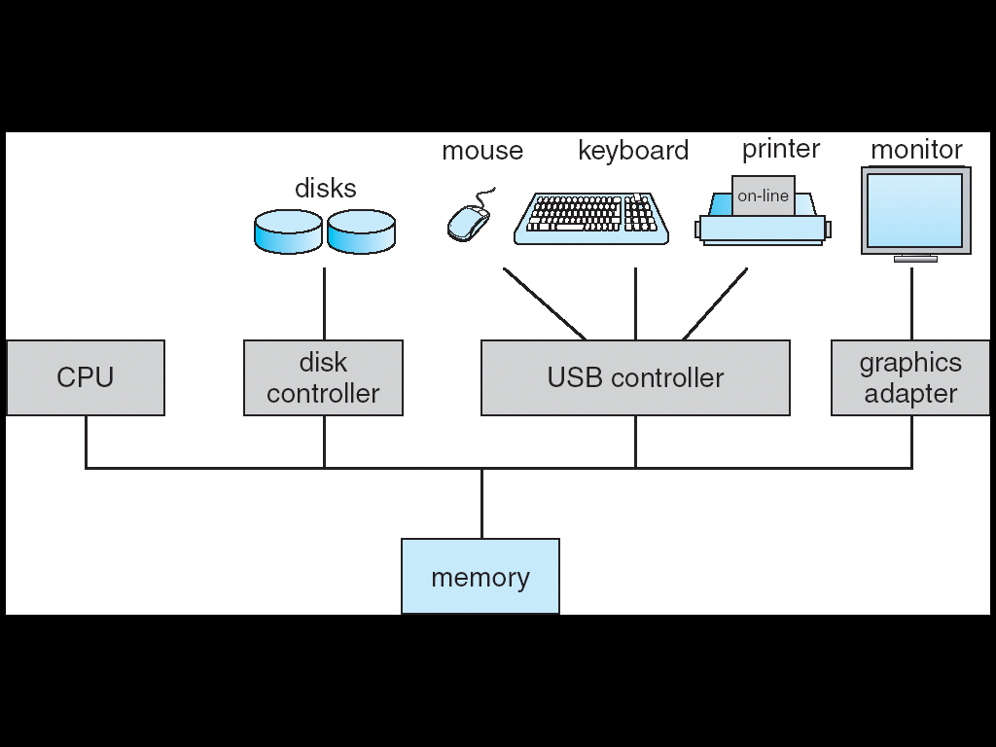
modern computer system
Complex system
Many H/W components
Many programs running simultaneously
Each running program
Executed in the CPU
Resides in the Memory
May Interact with several devices

Slide 7
modern computer system
To ensure the correct operation someone needs to
Understand how all these components work
Manage them wisely
Allocate them efficiently
A very challenging task!!!
If application programmer had to consider everything
So, computers are equipped with a special software
THE OPERATING SYSTEM

Slide 8
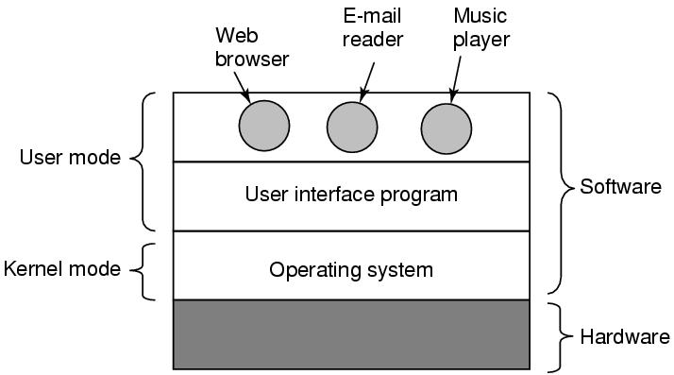
operating system
A collection of exceptionally complex programs
Runs on the bare hardware and provides the base for all the other software
Makes the computer system easy to use
Simplify application development by providing standard services and abstractions

Slide 9
Why Study OS?
Learn how to build complex systems:
How does H/W & S/W interact?
Engineering issues:
How do large distributed systems work?
What are the tradeoff among different design choices?
Buying and using a personal computer:
Why different PCs with same CPU behave differently
Should you get Windows 8, Linux or Mac OS …?
Security, viruses, and worms
What exposure do you have to worry about?

Slide 10
Role of OS
An extended machine
Provide application programmers a clean abstract set of resources instead of the messy hardware ones
A resource manager
Manage the hardware resources(Book 36)
Notes:
-> Operating System provides a simple, high level abstraction such that these devices contain a collection of named files.
-> Such files consist of useful piece of information like a digital photo, e mail messages, or web page.
Operating System provides a set of basic commands or instructions to perform various operations such as read, write, modify, save or close.
-> Dealing with them is easier than directly dealing with hardware.
-> Thus, Operating System hides the complexity of hardware and presents a beautiful interface to the users.
-> Just as the operating system shields (protect from an unpleasant experience) the programmer from the disk hardware and presents a simple file-oriented interface, it also conceals a lot of unpleasant business concerning interrupts, timers, memory management, and other low level features.
-> In each case, the abstraction offered by the operating system is simpler and easier to use than that offered by the underlying hardware.
-> In this view, the function of the operating system is to present the user with the equivalent of an extended machine or virtual machine that is easier to work with than the underlying hardware.
-> The operating system provides a variety of services that programs can obtain using special instructions called system calls.

Slide 11
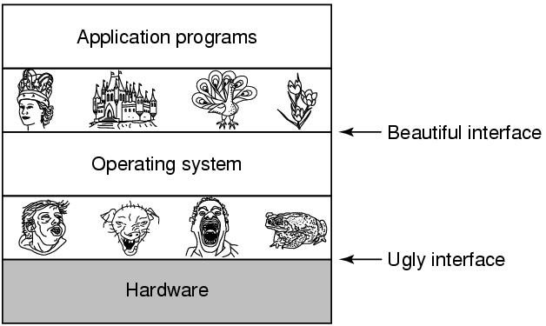

an Extended Machine
Operating systems turn ugly hardware into beautiful abstractions

Slide 12
an Extended Machine
Direct communication with hardware is very difficult
Need to understand the operation
Need low level programming
Consider direct read write to hard disk
What programmer wants is a simple, high-level abstraction to deal with hardware
The job of the OS
Create good abstractions
Implement and manage the abstract objects
Example:
OS abstracts hard disk by the file-system
Allow programmers to read write files without concern for how precisely they get stored

Slide 13
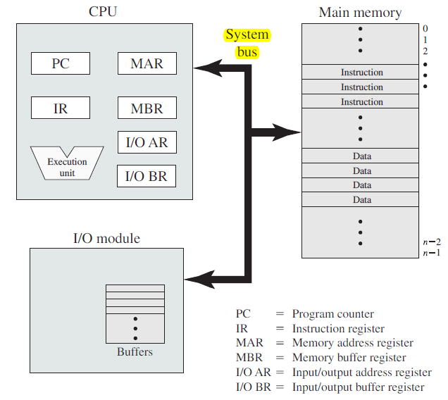
a resource manager
Allows multiple programs to run at the same time
Provide an orderly and controlled allocation of
Processors
Memories
I/0 devices
Among the competing programs
Example:
3 programs running on some computer
All tried to print their output simultaneously on the same printer
The OS can bring order to the potential chaos by buffering all the output on the disk

Slide 14
a resource manager
Resources can be shared in two different ways:
Time multiplexing:
In a single CPU system, several running programs take turns
Space multiplexing:
main memory is divided up among several running programs
OS has to implement these multiplexing

Slide 15
An Operating system
Makes a computer more convenient to use
Allows the resources to be used in efficient manner
Who are the real customers of OS?
End users
Application programmers

Slide 16
OS Operations

Slide 17
Some OS Components/Services/functions
Process Management
Memory Management
I/O Management
Deadlock Management
File system Management

Slide 18
Kernel
The most fundamental part of an OS
Running at all times on the computer
Often used as another name of OS
Typical components
interrupt handlers
to service interrupt requests
a scheduler
to share processor time among multiple processes
a memory management system
to manage process address spaces
system services
Networking, inter-process communication …

Slide 19
Dual-Mode Operation
CPU executes in 2 Modes
Kernel mode
CPU can execute all machine instructions
CPU can use every hardware feature
User mode
permits only a subset of the instructions and a subset of the hardware features to CPU

Slide 20
Dual-Mode Operation
OS runs in kernel mode, user programs in user mode
Allows OS to protect itself and other system components
OS is Boss, the applications are laborers
Mode bit provided by hardware
Provides ability to distinguish when system is running user code or kernel code

Slide 21
Dual-Mode Operation
When CPU starts executing in kernel mode?
System Boot
Starting a computer
Hardware Interrupt
generated by hardware devices to signal that they need some attention from the OS
Trap
a software-generated interrupt caused by
an error (i.e. division by 0 or invalid memory access)
a specific request from a user program for an operating-system service

Slide 22
Dual-Mode Operation
To obtain services from the operating system
a user program must make a system call, which traps into the kernel and invokes the operating system.
The TRAP instruction switches from user mode to kernel mode and starts the operating system.
When the work has been completed, control is returned to the user program at the instruction following the system call.

Slide 23
System Calls
Programming interface to the services provided by the OS
Typically written in a high-level language (C or C++)
Mostly accessed by programs via a library or Application Program Interface (API) rather than direct system call use
library or API Provides wrapper functions for the system calls
Typically a number is associated with each system call, and the OS maintains a table indexed according to these numbers.

